Slide 1

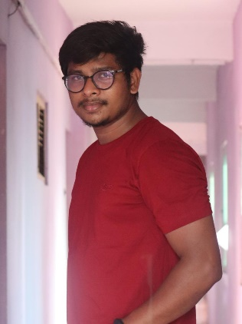





Venkata Ramana Nalla
Education and certificates
Bachelor of Technology in Computer Science.
Year of Passing: 2016-2020
Analyst/Software Engineer
Base Location: ^{Whitefield EPIP, Bangalore}
Email ID:
Venkata-ramana.nalla@capgemini.com
Skills
Core Java
SQL
_{Mobile No:} +91 9581363551
Grade:
A4
Database
SQL database – MySQL
Strengths
I can implement my Theoretical, Logical, Technical skills in the practical real life environment with committed & dedicated people, which will help me to explore myself fully and realize my potential.
Willing to work as a key player in challenging & creative environment. Also to secure a responsible career opportunity to fully utilize my training and skills, while making a significant contribution to the success of the company.
Ready to learn new technologies and implement them to further improve my knowledge.
Eager to work in a team of dedicated people and serve a key role in the enhancement and development of the project.
Achivement
Web Technologies
HTML
Examination and Evaluation System
Completed case study of Examination and Evaluation System done during the Training period.
Additional Details
Quick Learner
Time management
Disciplined and Responsible
Completed training in QJSpiders Hyderabad.
Core Java
SQL
Manual Testing
Additional Details
Excellent Communication Skills
Team Player
Areas of Interest and Hobbies Photography
Travelling
.
Presentation Title | Author | Date © Capgemini 2017. All rights reserved | 1
Check out my work on GitHub & Video Profile

